Slide 1

NextHikes IT Solutions
Flipkart Smartphone Market Analysis
Exploring pricing, brand trends & hardware specs across 541 smartphones
Presented by: Raj Bajaj

Slide 2
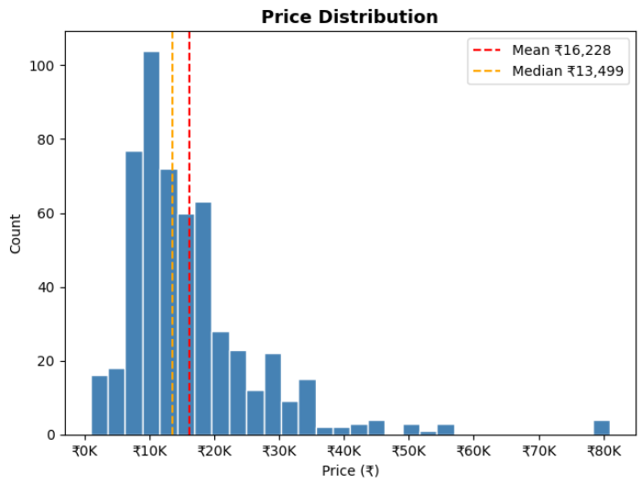
Market Segmentation :
Key Findings: The "Mid-Range" (₹10K-20K) segment is the most competitive, with the highest number of models .
Budget and Upper Mid-Range follow closely, showing a heavy focus on the "Value for Money" consumer.
Business Insight: Manufacturers are prioritizing the ₹10K–₹20K bracket because it represents the highest consumer volume in the market.

Slide 3
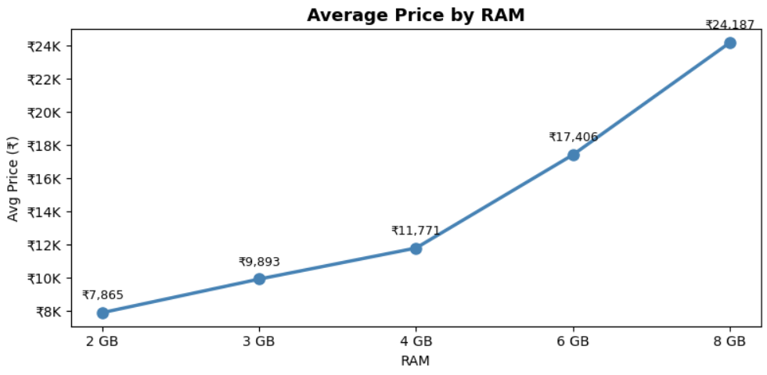
Price Drivers: The RAM Factor
Key Findings: There is a Strong Positive Correlation (0.78) between RAM and Price.
As RAM increases, price follows a predictable upward trend.
Business Insight: RAM remains the most significant "upsell" feature. Moving a consumer from 4GB to 8GB allows for a significant price premium that consumers are willing to pay for performance.

Slide 4
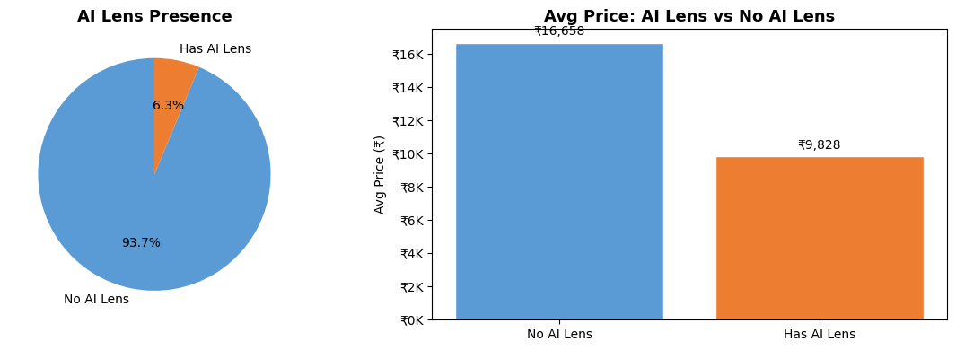
Feature Influence: AI Lens Battery
Key Findings: AI Lens Presence: Only a portion of phones feature dedicated "AI Lens" branding, but these models command a higher average price point.
Battery Standard: Over 60% of the market has standardized on 5000mAh, making battery size a "requirement" rather than a premium feature.
Business Insight: "AI" branding is currently used as a premium differentiator to move models into higher price segments, even when basic hardware like battery remains the same.

Slide 5
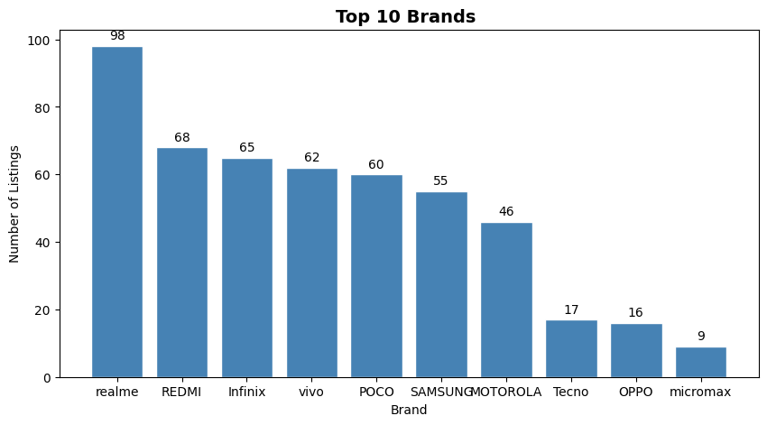
Brand Performance & Market Share:
Key Findings:
Market Leaders: Identify the top 3 brands (e.g., Vivo, Samsung, Realme) that dominate the dataset.
Brands with fewer models often target the "Premium" or "Ultra-Budget" segments rather than the mass market.
Business Insight: "Market dominance is currently achieved through variety. The leading brands have a model for every ₹2,000 price increment, leaving little room for smaller competitors."

Slide 6
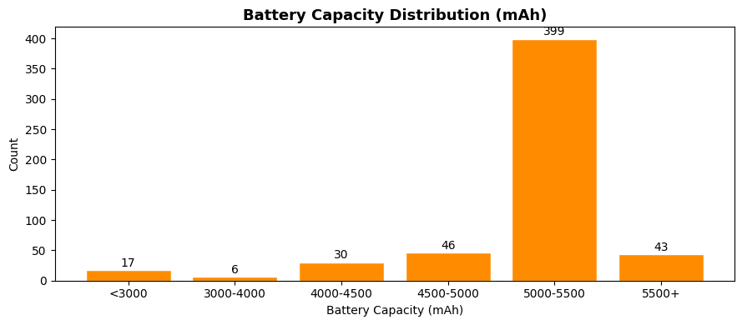
The Battery Trend:
Key Findings:
The 5000mAh Peak: Over 60% of smartphones across all price points have settled on exactly 5000mAh.
Low Correlation with Price: Surprisingly, battery size does not significantly increase with price.
Business Insight: "Battery capacity has become a commodity feature. A large battery is no longer a luxury; it is a baseline entry requirement.

Slide 7
Conclusion:
realme leads by volume
98 listings — followed closely by REDMI (68), Infinix (65), vivo (62), and POCO (60)
Lower-mid dominates pricing
46% of phones are priced ₹7K–₹15K; only 1.5% qualify as premium (₹50K+)
128 GB
Nearly half the catalog (259 phones) ships with 128 GB storage; 4 GB RAM is the most common tier
5000 mAh is the standard
72% of phones carry a 5000 mAh battery — the market has effectively standardized on this capacity
RAM correlates with price
Avg price jumps from ₹7,865 (2 GB) to ₹24,187 (8 GB) — but brand & processor also drive cost significantly

Slide 8
Thank You

